Slide 1

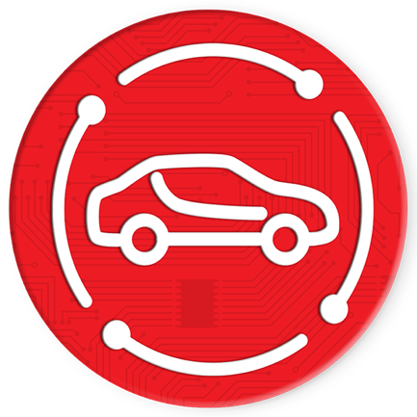
CAR SHARING
COMMUNITY
No Need To Buy Any Car

Slide 2

WHAT IS CAR SHARING COMMUNITY?
CAR SHARING COMMUNITY
CSC is a decentralized organization in the field of car sharing.
Car Sharing Community offers the Mycar mobile app, which you can use as Uber app.
Mycar uses blockchain technology for its car sharing service.
The driver is paid as soon as the customer pays.
The driver is paying more than other car sharing applications.
By applying blockchain technology, customers will be able to use lower priced services than other car sharing applications.
The drivers are rated by the customers with the voting features of the blockchain technology. Drivers’ data are saved on blockchain and can not be deleted.
Payments are fast, secure and private.
Customers and drivers are insured under CSC regulations.
No Need To Buy Any Car

Slide 3


WHAT IS CARCOIN?
CAR SHARING COMMUNITY
Carcoin is a token developed on the basis of ERC20 Ethereum Blockchain
No Need To Buy Any Car
3

Slide 4
CAR SHARING COMMUNITY ICO POLICY
CAR SHARING COMMUNITY
TITLE | PERCENT | QUANTITY | BLOCK
ICO | 50% | 95 Mil | Up to 24 Months
Development & IT | 10% | 19 Mil | Up to 48 Months
Buy GPS Map | 15% | 28.5 Mil | Up to 36 Months
Voting | 10% | 19 Mil | Up to 60 Months
Mycar App Marketing | 15% | 28.5 Mil | Up to 60 Months
Total | 100% | 190 Mil
No Need To Buy Any Car
4

Slide 5
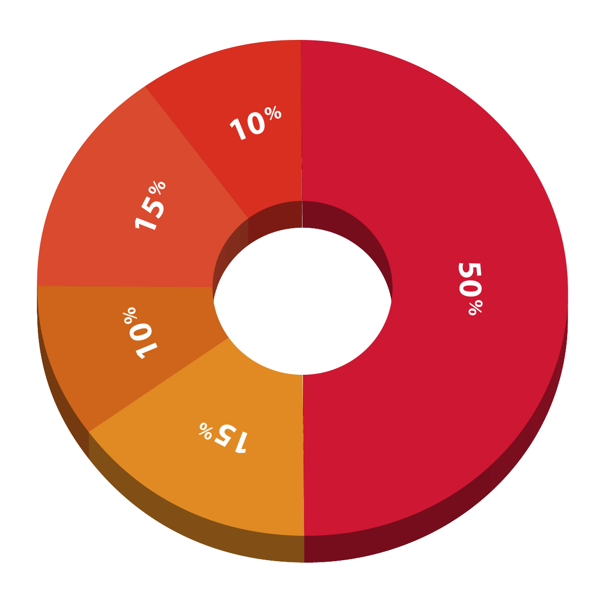
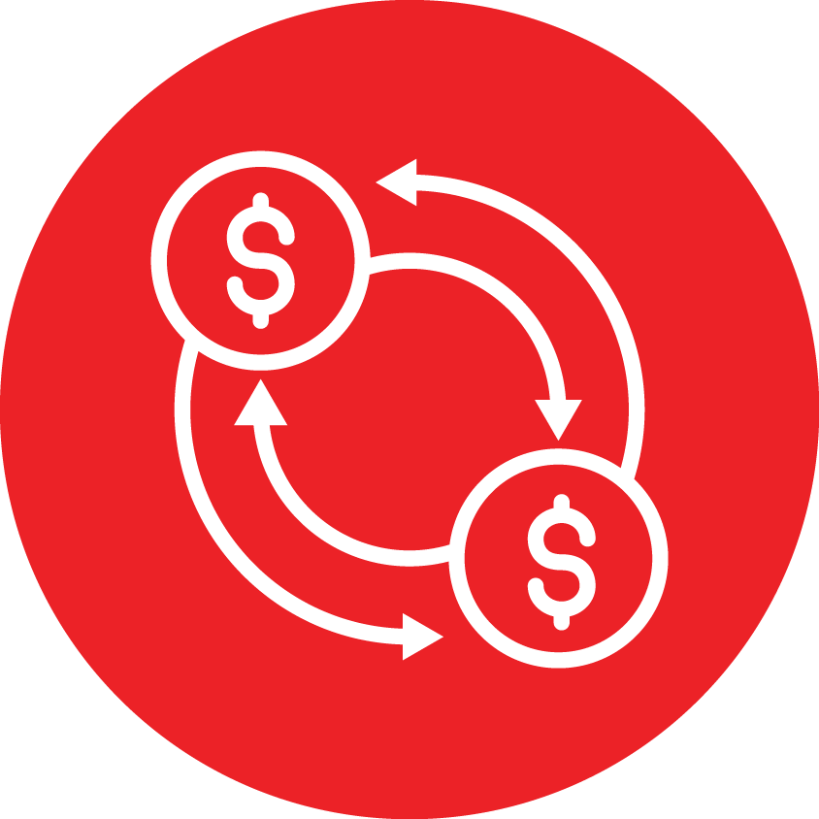




CAR SHARING COMMUNITY ICO POLICY
CAR SHARING COMMUNITY
50% ICO
10% DEVELOPMENT & IT TEAM
15% BUY GPS MAP
10% VOTING
TOTAL 190,000,000
15% MYCAR APP MARKETING
No Need To Buy Any Car

Slide 6
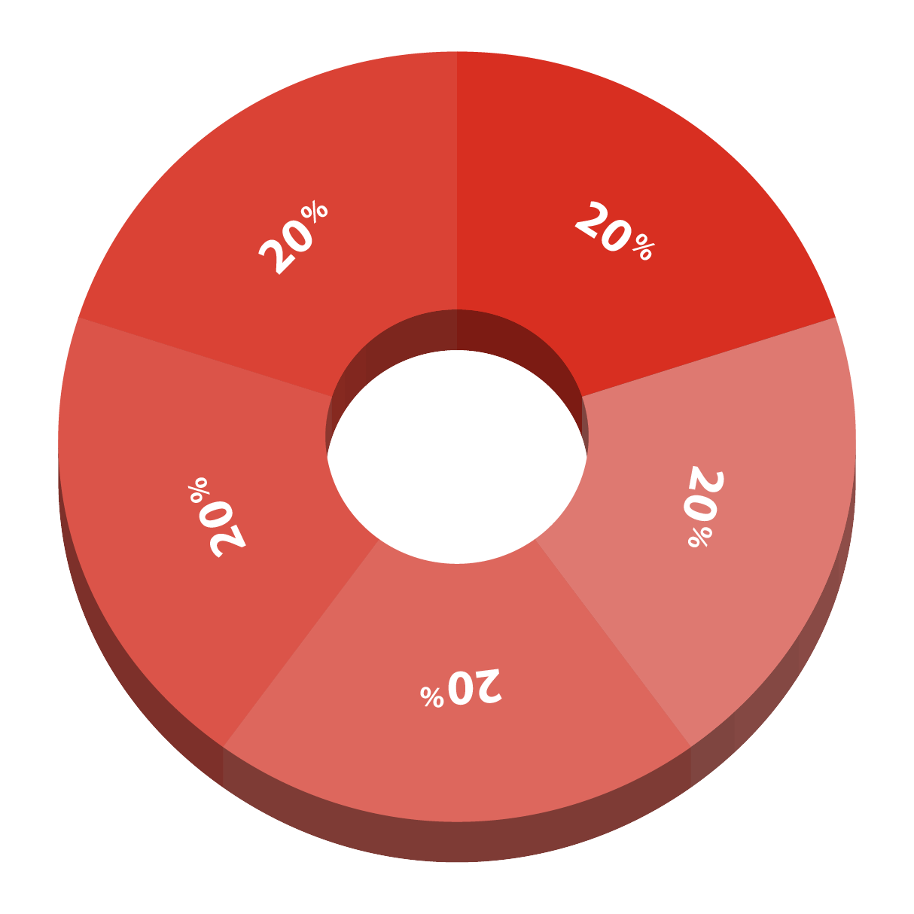
CAR SHARING COMMUNITY ICO POLICY
CAR SHARING COMMUNITY
20% ARE LOCKED IN 6 MONTHS
20% ARE LOCKED IN 12 MONTHS
20% ARE LOCKED IN 24 MONTHS
20% ARE LOCKED IN 36 MONTHS
20% ARE LOCKED IN 48 MONTHS
DEVELOPMENT & IT TEAM
No Need To Buy Any Car

Slide 7
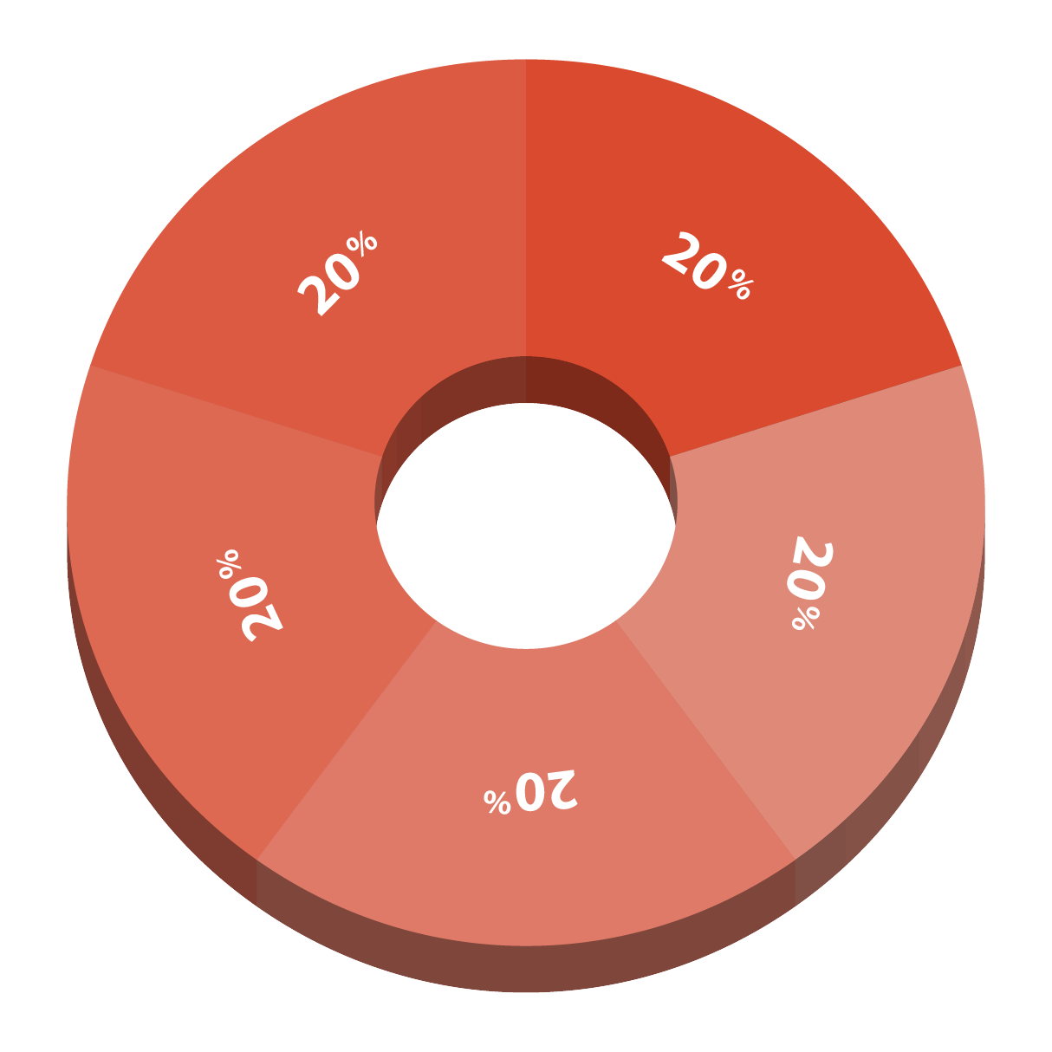
CAR SHARING COMMUNITY ICO POLICY
CAR SHARING COMMUNITY
20% ARE LOCKED IN 12 MONTHS
20% ARE LOCKED IN 18 MONTHS
20% ARE LOCKED IN 24 MONTHS
20% ARE LOCKED IN 30 MONTHS
20% ARE LOCKED IN 36 MONTHS
BUY & BUILD GPS MAP
No Need To Buy Any Car

Slide 8
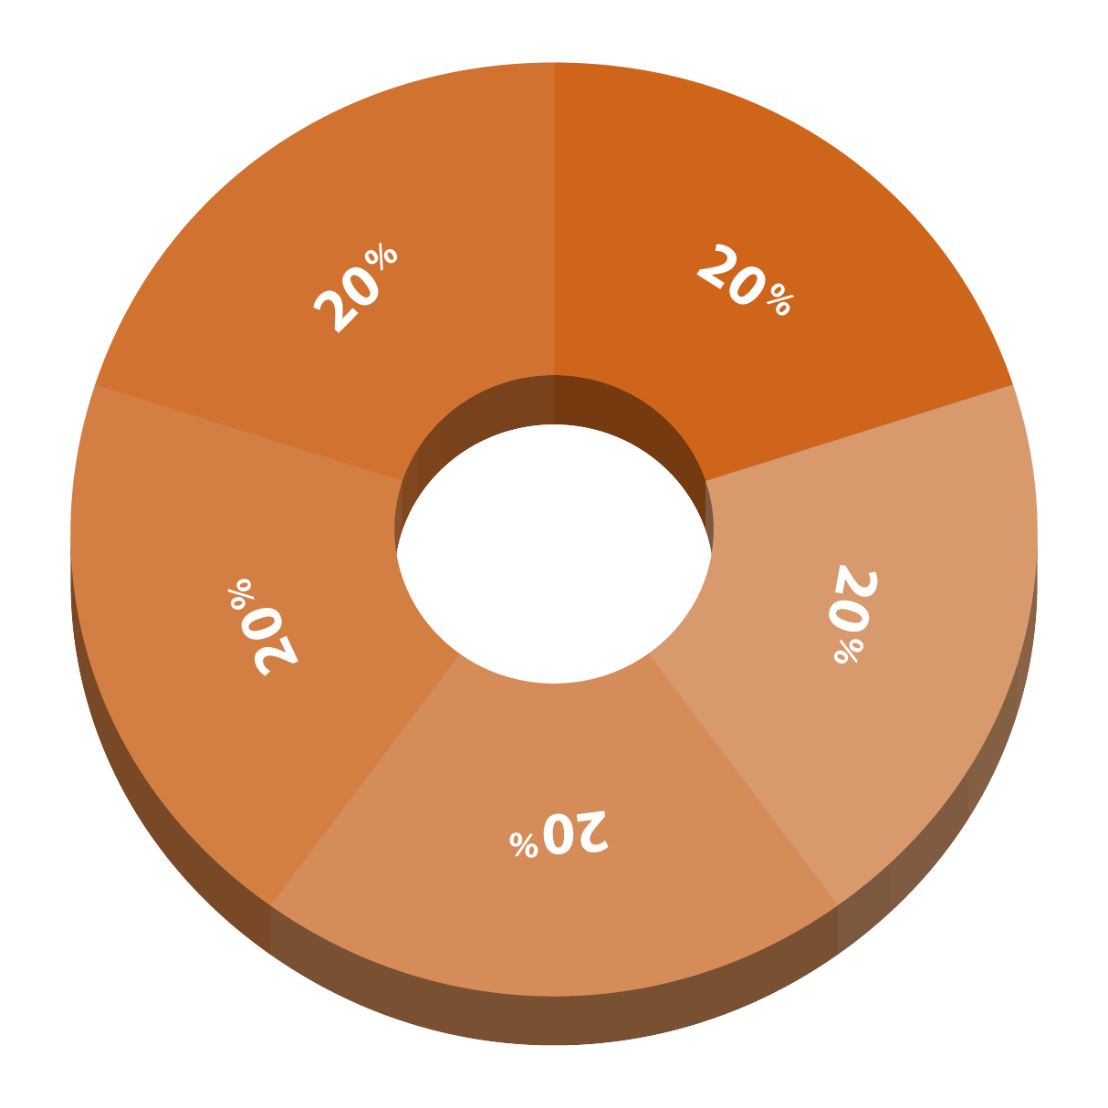
CAR SHARING COMMUNITY ICO POLICY
CAR SHARING COMMUNITY
20% ARE LOCKED IN 24 MONTHS
20% ARE LOCKED IN 36 MONTHS
20% ARE LOCKED IN 48 MONTHS
20% ARE LOCKED IN 54 MONTHS
20% ARE LOCKED IN 60 MONTHS
VOTING
No Need To Buy Any Car

Slide 9
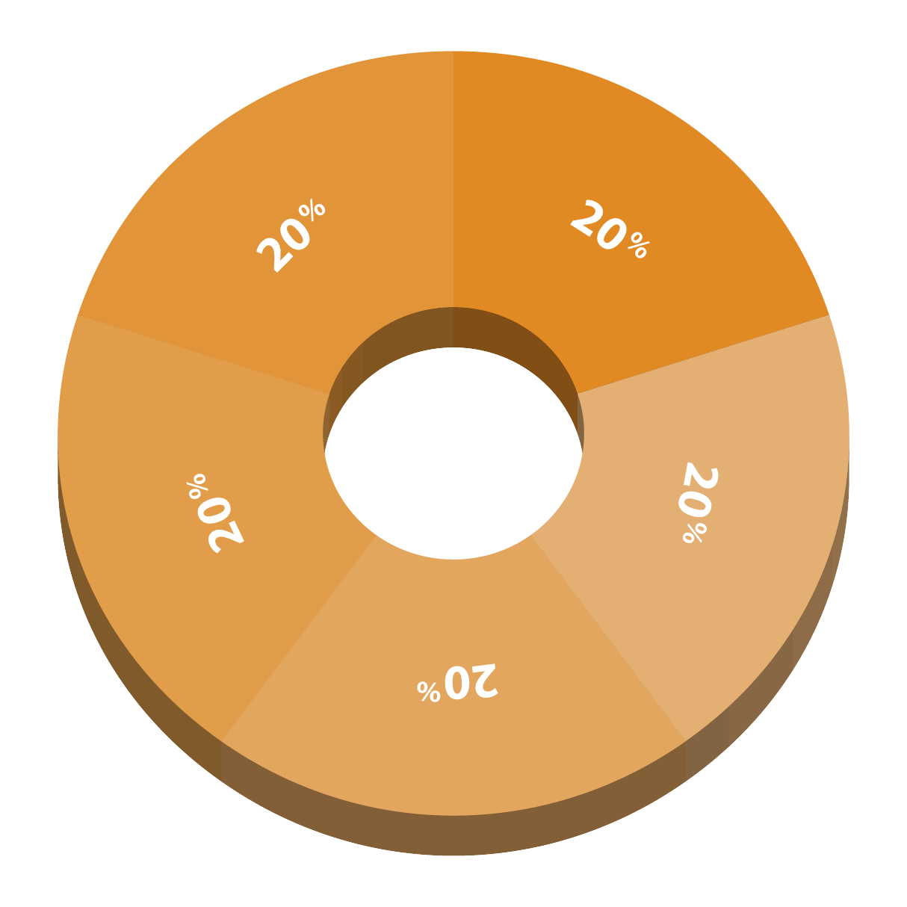
CAR SHARING COMMUNITY ICO POLICY
CAR SHARING COMMUNITY
20% ARE LOCKED IN 18 MONTHS
20% ARE LOCKED IN 24 MONTHS
20% ARE LOCKED IN 36 MONTHS
20% ARE LOCKED IN 48 MONTHS
20% ARE LOCKED IN 60 MONTHS
MYCAR APP MARKETING
No Need To Buy Any Car

Slide 10
ICO MAP
CAR SHARING COMMUNITY
TIME | TITLE | PRICE
9-31/12/2017 | Auction(4.6mil) | $0.3-$0.9
01/2018 | Lending | $1.5 Up
01/2018 | C-Cex.com | $2 Up
02/2018 | Livecoin.net | $5 Up
03/2018 | Carcoin Exchange | $10 Up
07/2018 | Open Ecosystem | $20 Up
12/2018 | Buy & Built GPS Map | $50 Up
12/2019 | Launching Mycar App | $200 Up
No Need To Buy Any Car

Slide 11
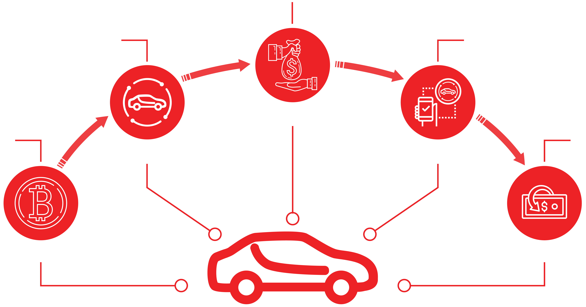
CAR SHARING COMMUNITY LENDING
CAR SHARING COMMUNITY
Lending
Buy Carcoin from CSC exchange
Earn Interest and convert to Carcoin
LENDING
Deposit your Bitcoin on given bitcoin deposit address
Capital withdrawal and convert to Carcoin
BUY CARCOIN
EARN DAILY PROFIT
DEPOSIT BITCOIN
CAPITAL WITHDRAW
No Need To Buy Any Car

Slide 12
LENDING PLAN - PAID DAILY
CAR SHARING COMMUNITY
LENDING AMOUNT | VOLATILITY SOFTWARE INTEREST | BONUS | CAPITAL RELEASE | REFERRAL
$200-$1,000 | Up to 24% per Month |  | 299 Days | 7%
$1,010-$10,000 | Up to 24% per Month | + 0.1% Daily | 239 Days | 8%
$10,010-$50,000 | Up to 24% per Month | + 0.15% Daily | 179 Days | 9%
$50,010-$100,000 | Up to 24% per Month | + 0.2% Daily | 120 Days | 10%
No Need To Buy Any Car

Slide 13
INFINITY BONUS
CAR SHARING COMMUNITY
PACKAGE | SALE LEFT | SALE RIGHT | BONUS
$200-$1,000 | $1,000 | $1,000 | 4%
$1,010-$10,000 | $10,000 | $10,000 | 6%
$10,010-$50,000 | $100,000 | $100,000 | 8%
$50,010-$100,000 | $200,000 | $200,000 | 10%
Max Out: 30.000$ Weekly
No Need To Buy Any Car

Slide 14
INFINITY INTEREST BONUS
CAR SHARING COMMUNITY
PACKAGE | SALE LEFT | SALE RIGHT | BONUS
$200-$1,000 | $500 | $500 | 8%
$1,010-$10,000 | $3,000 | $3,000 | 10%
$10,010-$50,000 | $30,000 | $30,000 | 12%
$50,010-$100,000 | $50,000 | $50,000 | 14%
Max Out: 30.000$ Weekly
No Need To Buy Any Car

Slide 15
GLOBAL BONUS - PAID MONTHLY
CAR SHARING COMMUNITY
RANK | TO ACHIEVE RANK |  |  | GLOBAL BONUS POOL
 | LENDING AMOUT | GENERATIONAL VOLUME
 |  | LEFT | RIGHT
SAPPHIRE | $1,010-$10,000 | $20,000 | $20,000 | 2%
EMERALD | $10,010-$50,000 | $50,000 | $50,000 | 1.5%
DIAMOND | $50,010-$100,000 | $100,000 | $100,000 | 1%
BLUE DIAMOND | $50,010-$100,000 | $200,000 | $200,000 | 0.75%
BLACK DIAMOND | $50,010-$100,000 | $500,000 | $500,000 | 0.5%
No Need To Buy Any Car

Slide 16
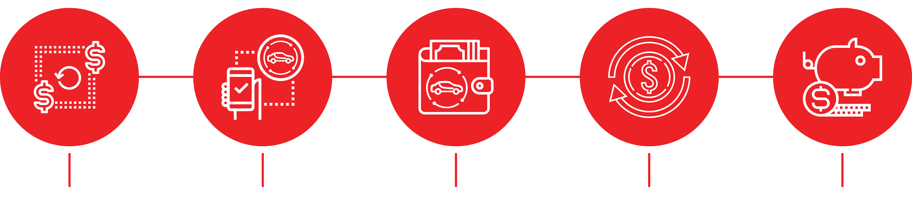
BONUS POLICY
CAR SHARING COMMUNITY
EXCHANGE/TRANSFER
EARN DAILY PROFIT
60% TO CARCOIN WALLET
40% REINVEST
EARN BONUS
No Need To Buy Any Car

Slide 17
Thank You
CAR SHARING COMMUNITY

